Slide 1
Smart Monitoring and Prediction system of Agriculture
Supervised by: Mr. Mirza Shahriyar Baig

Slide 2


Slide 3
Group Members:-
Muhammad Muaz (FA18-BSCS-320-H)
Rana Muhammad Zaryab Khan (FA18-BSCS-339-H)

Slide 4
Introduction: -
The purpose of this project is to help the farmers and the people related to the field of agriculture and also the concerns regarding to this project are really considerable with all the parameters such as Economy of country, population, developing technologies, etc. Here are some benefits/purposes listed that how this project can handle real time issues and why we choose this project.
Easy-Monitoring. Easy-Prediction.
Eco-Friendly. Less Work.
Overcome Demand. Labor Cost.

Slide 5
Introduction: -
A farmer decision about which crop to grow is generally clouded by his intuition and other irrelevant factors like making instant profits, lack of awareness about market demand, overestimating a soils potential to support a particular crop and so on.
The need of the hour is to design a system that could provide predictive insights to the farmers, thereby helping them make an informed decision about which crop to grow.
This calls for the need of smart farming, which requires use of IoT. Application of IoT in agriculture could be a life changer for humanity and the whole planet. That’s why we choose to build a system for monitoring and prediction of crops.

Slide 6
Problem Statement: -
The problem with traditional ways of farming is very tedious and they need more hard work as the farmers have to go to lands to check whether there is any need of water or anything else.
As this is the fact that our country’s population is majorly related to the agricultural sector. The GDP of our country is based on the revenue generated from agriculture sector. So, it’s a good thing to work in the main field which directly or indirectly connected with the stability of government.
There are field problems, which needs to solved through technology, such as land monitoring, water level checking, wastage of water, wastage of resources etc.

Slide 7
Solution: -
The proposed system on which we worked is a Smart Agriculture system that will perform automated monitoring and predications using IOT technology.
This proposed system will enable farmers to monitor their lands remotely and increase the production of crops by using the prediction feature of the system which predicts which crop is better for their land to increase productivity.
Smart Monitoring and Prediction system of Agriculture is a self-Contained Product.
By automating and using the technology in the sector of agriculture will increase the productivity, income and reduce the supply chain gap and also helps the farmers to grow well.

Slide 8
Requirements: -
Software Requirement:
Android Studio.
Arduino IDE.
C
Hardware Requirements:
Arduino Board. Node-MCU.
Temperature and Humidity sensor. Soil Moisture senor.
Air Quality sensor. I2C-Display
NPK sensor/kit. Rain sensor.
Mobile device for app. System for coding.

Slide 9
Requirements: -
Basic Other Requirements:
Our system need internet Connectivity.
Land to run the system.
Internet Connection for the App.

Slide 10
Functionalities: -
The functionality of the Application is to provide the complete requirement guidance to the Farmer Such as:
Temperature and Humidity Level. Soil Moisture Level.
Soil Nutrient values. Soil fertility.
Predicts which Crop is best for their field.
Alerts the Farmer if the water goes below the limit.
Allow them to monitor from anywhere and anytime.
Eco-Friendly. Cost Effectively.
Increase productivity to overcome the demand.

Slide 11
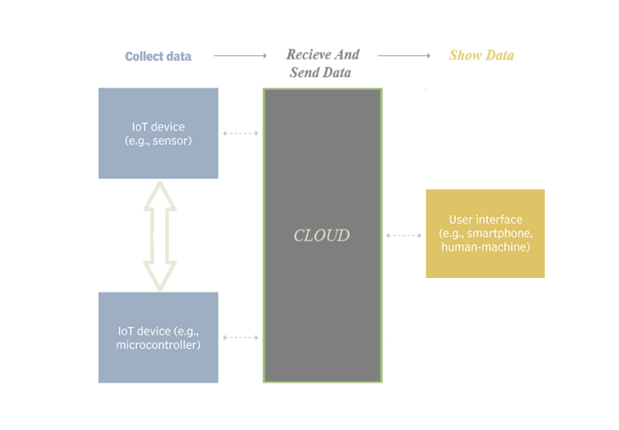
Main architecture: -

Slide 12
Future work: -
In future, we are thinking of creating and connecting a complete responsive website for our system of Monitoring and Prediction of agriculture. Secondly, the range of prediction can improve to large extent by adding more crops data to our database. Furthermore, the scope of the project would escalate by adding more operations such as weather prediction etc.

